Slide 1

Coordination model and digital twins for managing energy consumption and production in a smart grid.
Digital Twins session, November 7th 2024
Philippe Glass

Slide 2

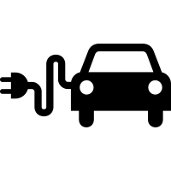

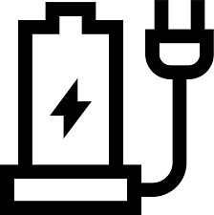
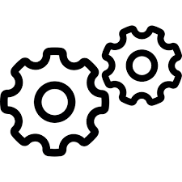
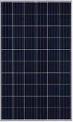
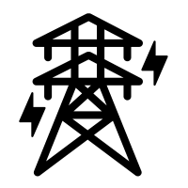
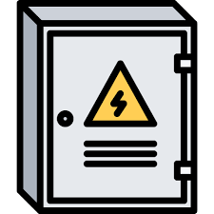




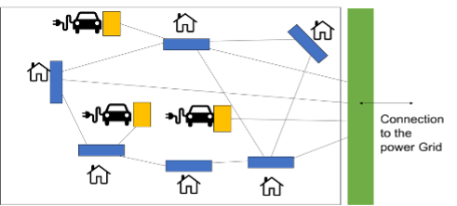
Coordination platform to ensure interaction between nodes
node
node
node
node
Coordination platform
Connection
to the
Power Grid
node
Interactions between nodes for :
– Exchanging electricity
– Peak shaving
– Gossip Learning
(algorithms)
Flow of information
node
Flow of electricity
Digital Twins session, November 7th 2024

Slide 3
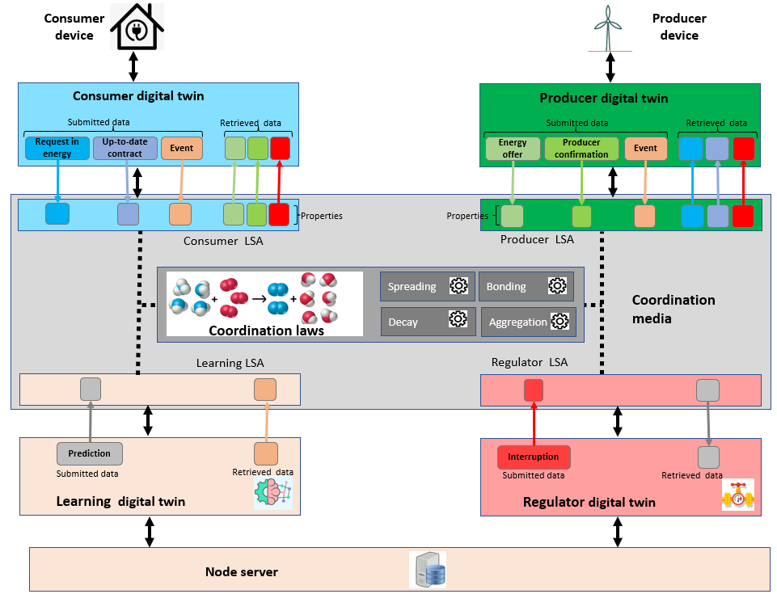
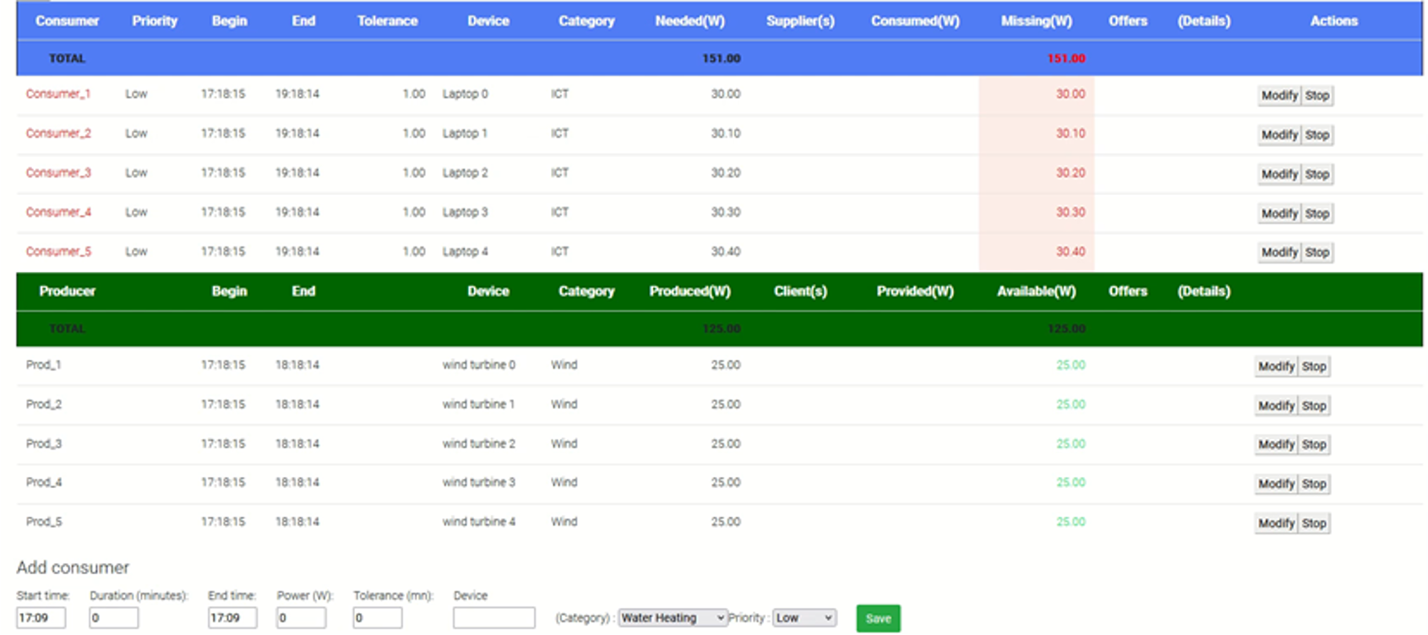
Coordination platform and digital twins for exchanging energy
Digital twins: agents' behaviours as
consumer
producer
learning agent
regulator
Agents act autonomously, adapt, organize, and make decisions according to the situation.
Dynamic self-adaptive generation of supply contracts between producers and consumers
Digital Twins session, November 7th 2024

Slide 4
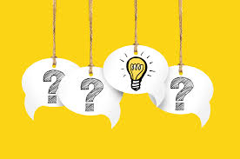
Questions
Digital Twins session, November 7th 2024

Slide 5
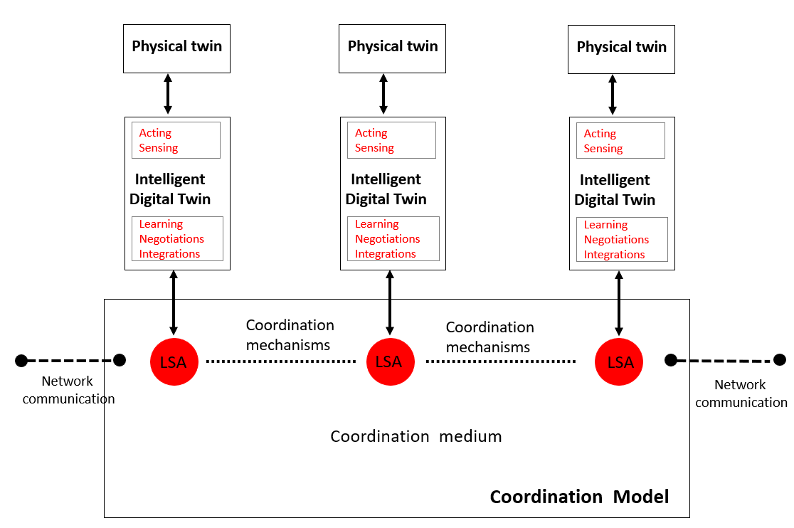
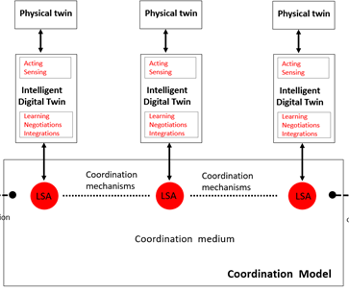
Method: coordination model and platform
Implementation of a coordination platform using:
digital twins,
shared virtual environment (tuple space)
coordination laws.
Digital Twins session, November 7th 2024

Slide 6

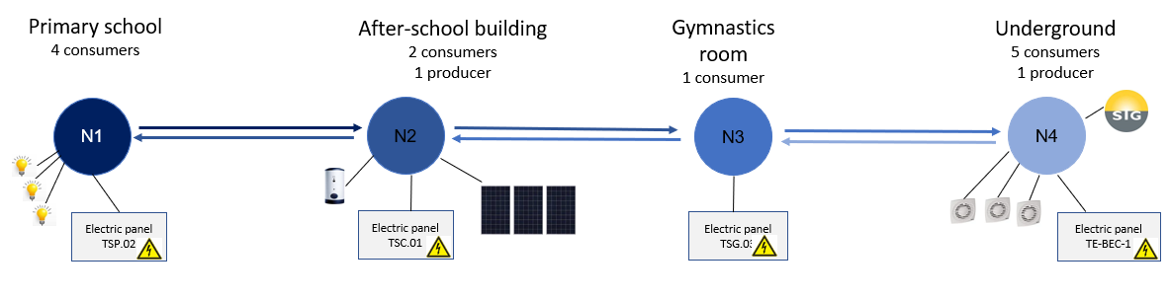
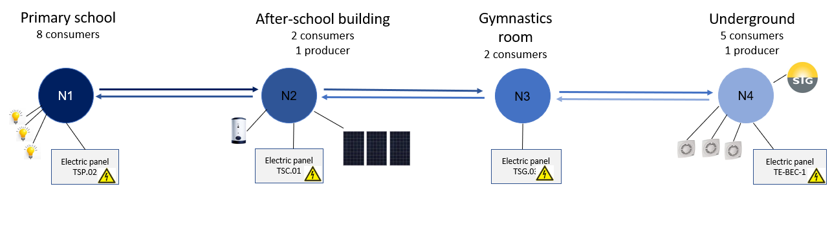
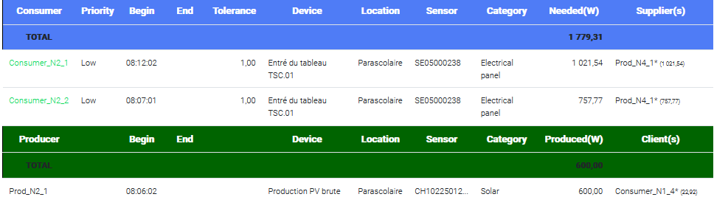
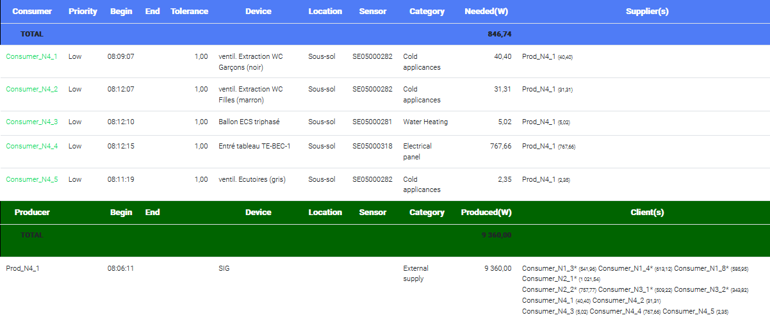
Tuning of the coordination platform to match with the living lab configuration
“Chain” topology with 4 nodes(1 or 2 neighbours by node)
Digital Twins session, November 7th 2024

Slide 7
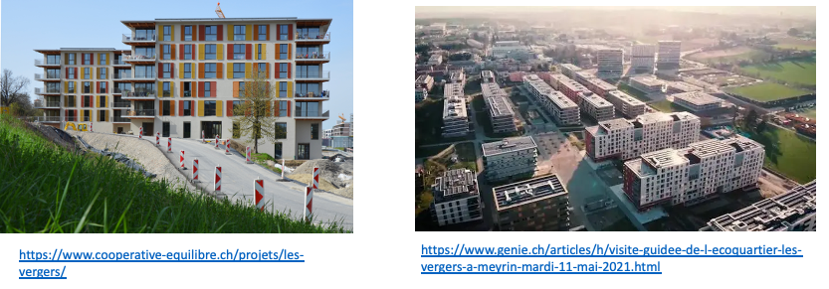
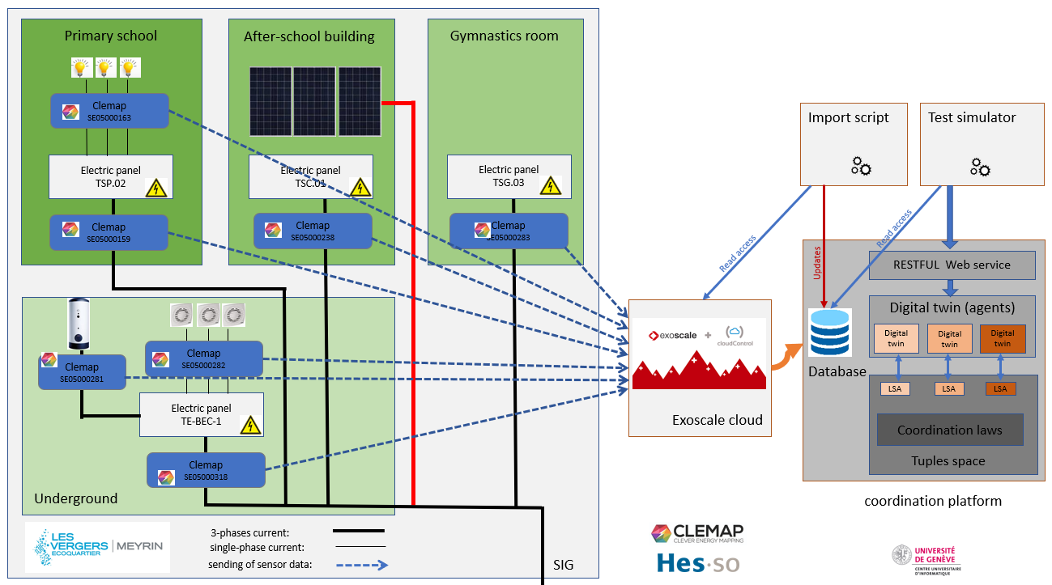
Tuning of the coordination platform to match with the living lab configuration
Power measurements by smart-meters.
Storage of measurement history.
Digital Twins session, November 7th 2024

Slide 8

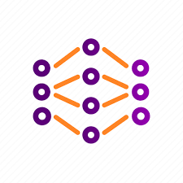






Gossip Federated Learning : zoom on a Grid Edge Device
GED 1
GED 2
GED n
Neighbouring Edge Devices
Learning twin
Learning
Model
Learning twin
Learning
Model
Learning twin
Learning
Model
…
Coordination platform
Coordination platform
Coordination platform
W$j$^{k,1}
…
W$j$^{k,2}
W$j$^{k,n}
GED 1,2, … n Learning model weights
GED k Model weights
GED k Model weights
GED k Model weights
GED 1 Model weights
GED 2 Model weights
GED N Model weights
GED k
Aggregation applied to leaning model weights:
Spreading
W$j$^{k}
W$j$^{k,1}
W$j$^{k,2}
W$j$^{k,n}
All GED learning models have the same structure.
W_{j+1}^{k}
Aggregation mechanism
Bonding
Each GED manages model distribution and aggregation.
Decay
Model weights
W_{j}^{k}
Coordination platform
Mechanism generalised to any model : aggregation functions defined in learning model
Learning twin
Learning
Model
Digital Twins session, November 7th 2024

Slide 9
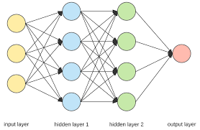
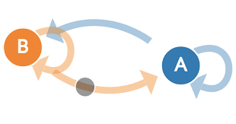
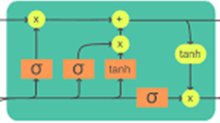
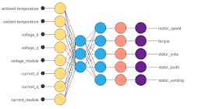
Gossip-Based Ensemble Learning with coordination platform
GED-1 Learning
model
GED-2 Learning
model
GED-n Learning
model
…
calculation of predictions
GED-1 Prediction
GED-2 Prediction
GED-n Prediction
Coordination platform
Coordination platform
Coordination platform
GED 1
GED 2
GED n
Prediction
Prediction
Prediction
GED k
Spreading
GED-k Prediction
GED-1 Prediction
GED-2 Prediction
GED-n Prediction
Aggregation applied to predictions:
GED-k Prediction
Aggregation mechanism
Bonding
GEDs can have different learning model type.
Decay
Coordination platform
GED-k Prediction
Each EGD manages model distribution and aggregation.
GED-k Learning
model
Digital Twins session, November 7th 2024

